Slide 1

KILL BILL
Advisor: senem KUMOVA metİn
Project by: barış erenler
Kerem can Özcan
Mehmet algül
Metİn akin
Utku aksakallı

Slide 2
CONTENT
Introduction
Project Definition
Project Purpose
Raspberry Pi System
Plan B
Mobile Application
Comparison with other similar applications
Conclusion

Slide 3
KILL BILL: Project Members and Responsibilities
Project Manager
Metin Akın
UI Designer
Mehmet Algül
Development Team 1
Kerem Can Özcan
Metin Akın
Development Team 2
Barış Erenler
Mehmet Algül
Utku Aksakallı

Slide 4
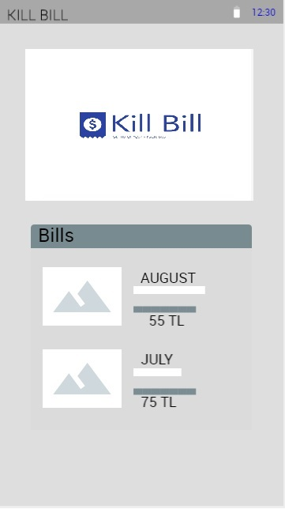
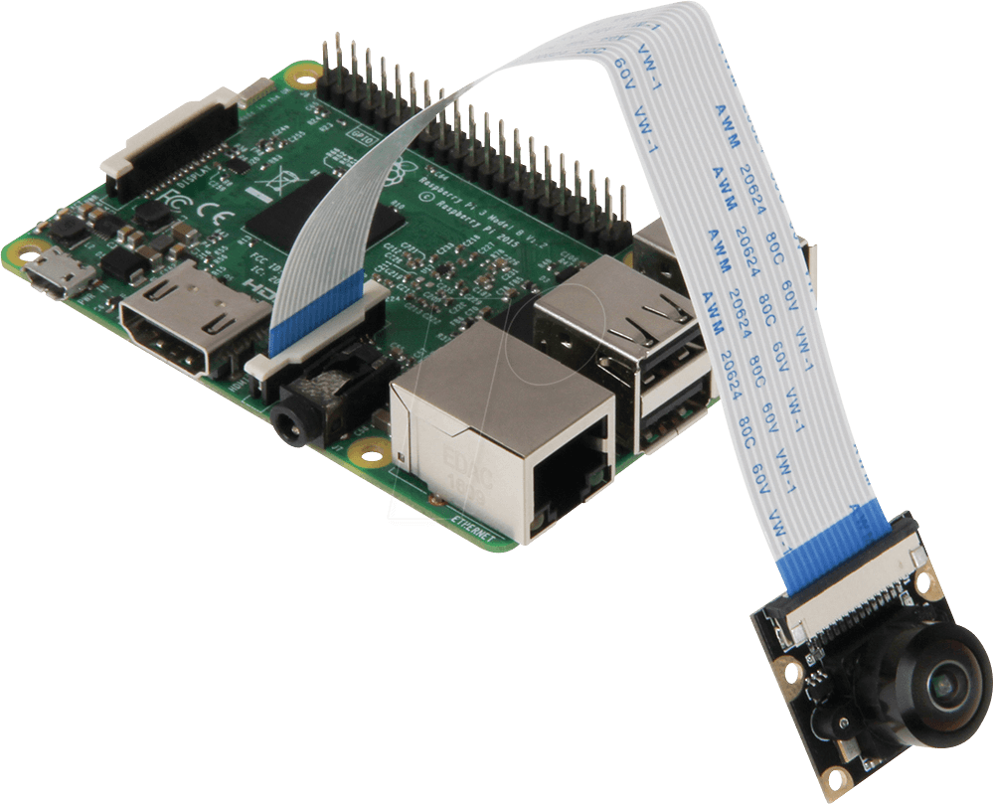
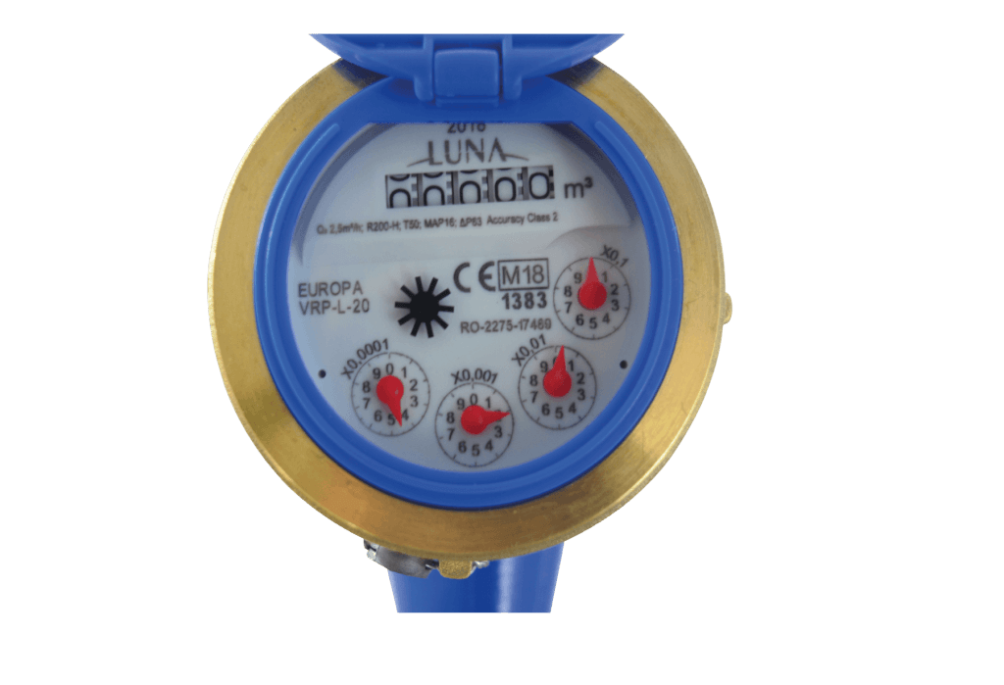
KILL BILL
Kill Bill is the project which is planned to develop for that users can track their bills group by water, electricity and natural gas costs instantly by mobile phone.
Households
Industrial Comp.
Public Ins.
Construction Comp.

Slide 5
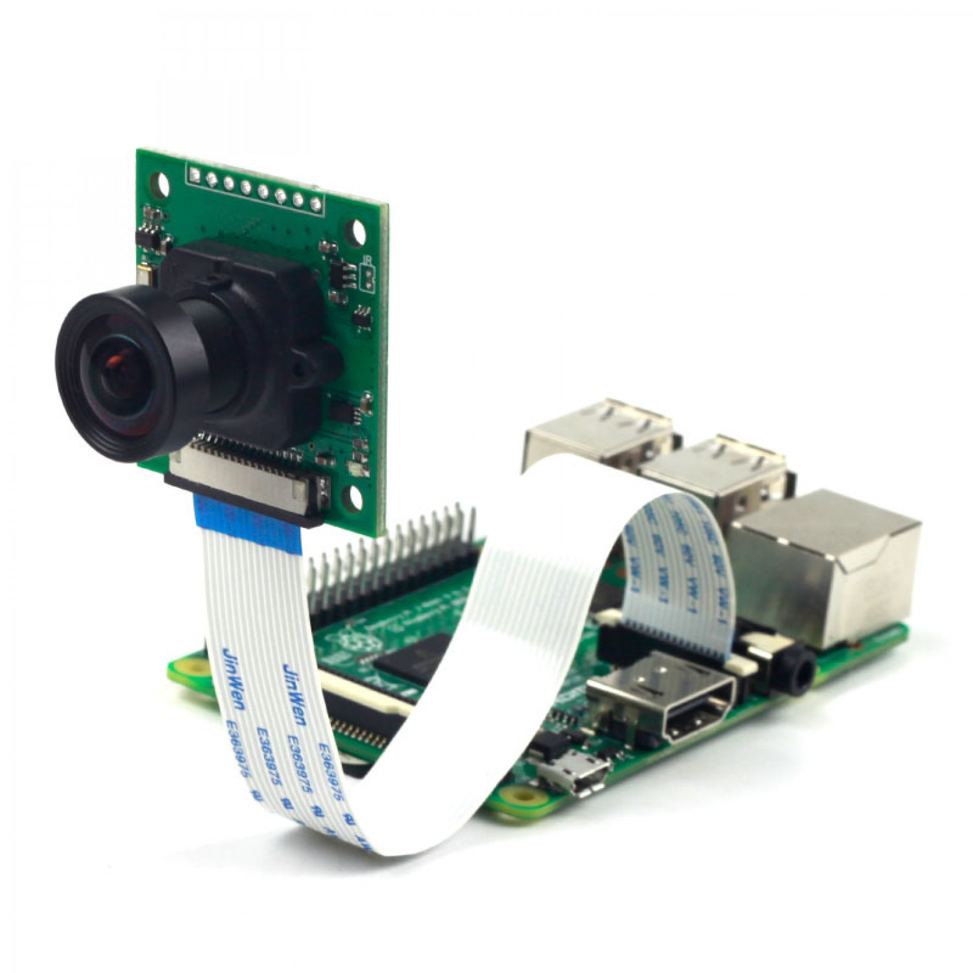
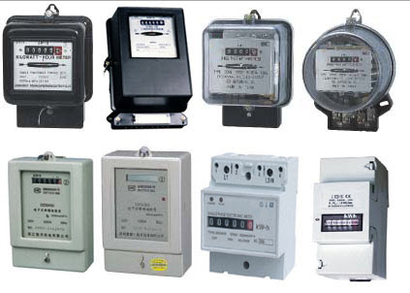
KILL BILL
How works KILL BILL?

Slide 6
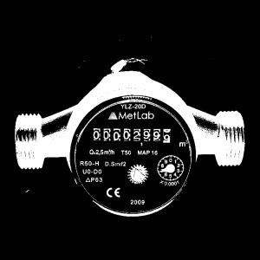
KILL BILL
00002999

Slide 7
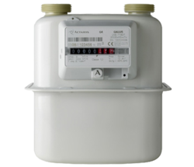
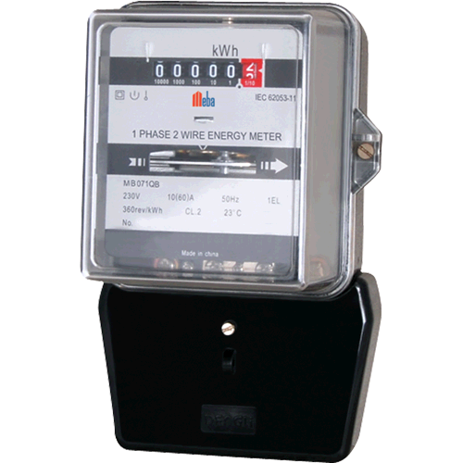
KILL BILL
Three different meters;

Slide 8
KILL BILL
WATER METER

Slide 9
KILL BILL
MATHEMATICAL FORMULATION OF WATER BILL
Maintenance cost is 1 m3 water price which is 4.58 TL
8% VAT will be added to water price and maintenance cost.
50.38 x 0.08 = 4.03 TL
Consumption tax was 2.8 TL in 2018.
Total water bill cost will be 45.8 + 4.58 + 4.03 TL + 2.8 = 57 TL.

Slide 10
KILL BILL
ELECTRICITY METER

Slide 11
KILL BILL
MATHEMATICAL FORMULATION OF ELECTRICITY BILL
Energy Unit Price X kWh =Energy Cost (A)
Distribution Unit Price X kWh =Distribution Cost (D)
Energy Cost (A) X %1 =Energy Fund Cost (F)
Energy Cost (A) X %5 =Electricity Consumption Tax (T)
Energy Cost (A) X %2 =TRT Fee (R)
+ (D) + (F) + (T) + (R) = Billing Price except VAT
Billing Price except VAT x (1 + %18) = Total Billing Price

Slide 12
KILL BILL
NATURAL GAS METER

Slide 13
KILL BILL
MATHEMATICAL FORMULATION OF NATURAL GAS BILL
Measured Volume(m3) = Last Index - First Index,
Fixed Usage(m3) = Measured Volume(m3) x Correction Factor (K)
Usage (kWh) = Fixed Usage (m3) x invoicing period upper thermal value (kcal/m3)
860,42 (kcal/kWh)
Consumption Cost (TL) = Usage(kWh) x Average Price (TL/kWh)
System Usage Fee (TL) = Usage (kWh) x System Usage Fee Unit Price (TL/kWh)
VAT = Usage Price (System Usage Fee included) x 0,18
Billing Price = Usage Price + System Usage Fee + VAT

Slide 14
KILL BILL: Possible Problems
Digital meters and timing of digital meters
Reflection of the flash light from the glass
Character types of different meters
The changing characters
Other possible problems with image processing part
Problems due to hardware

Slide 15
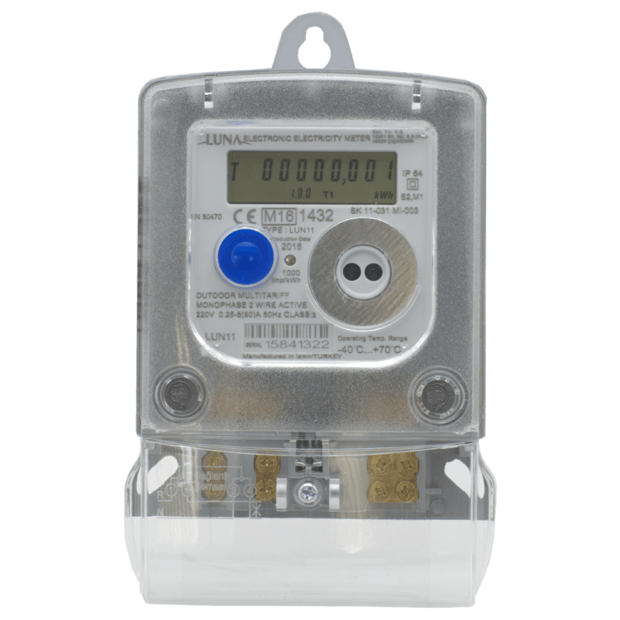
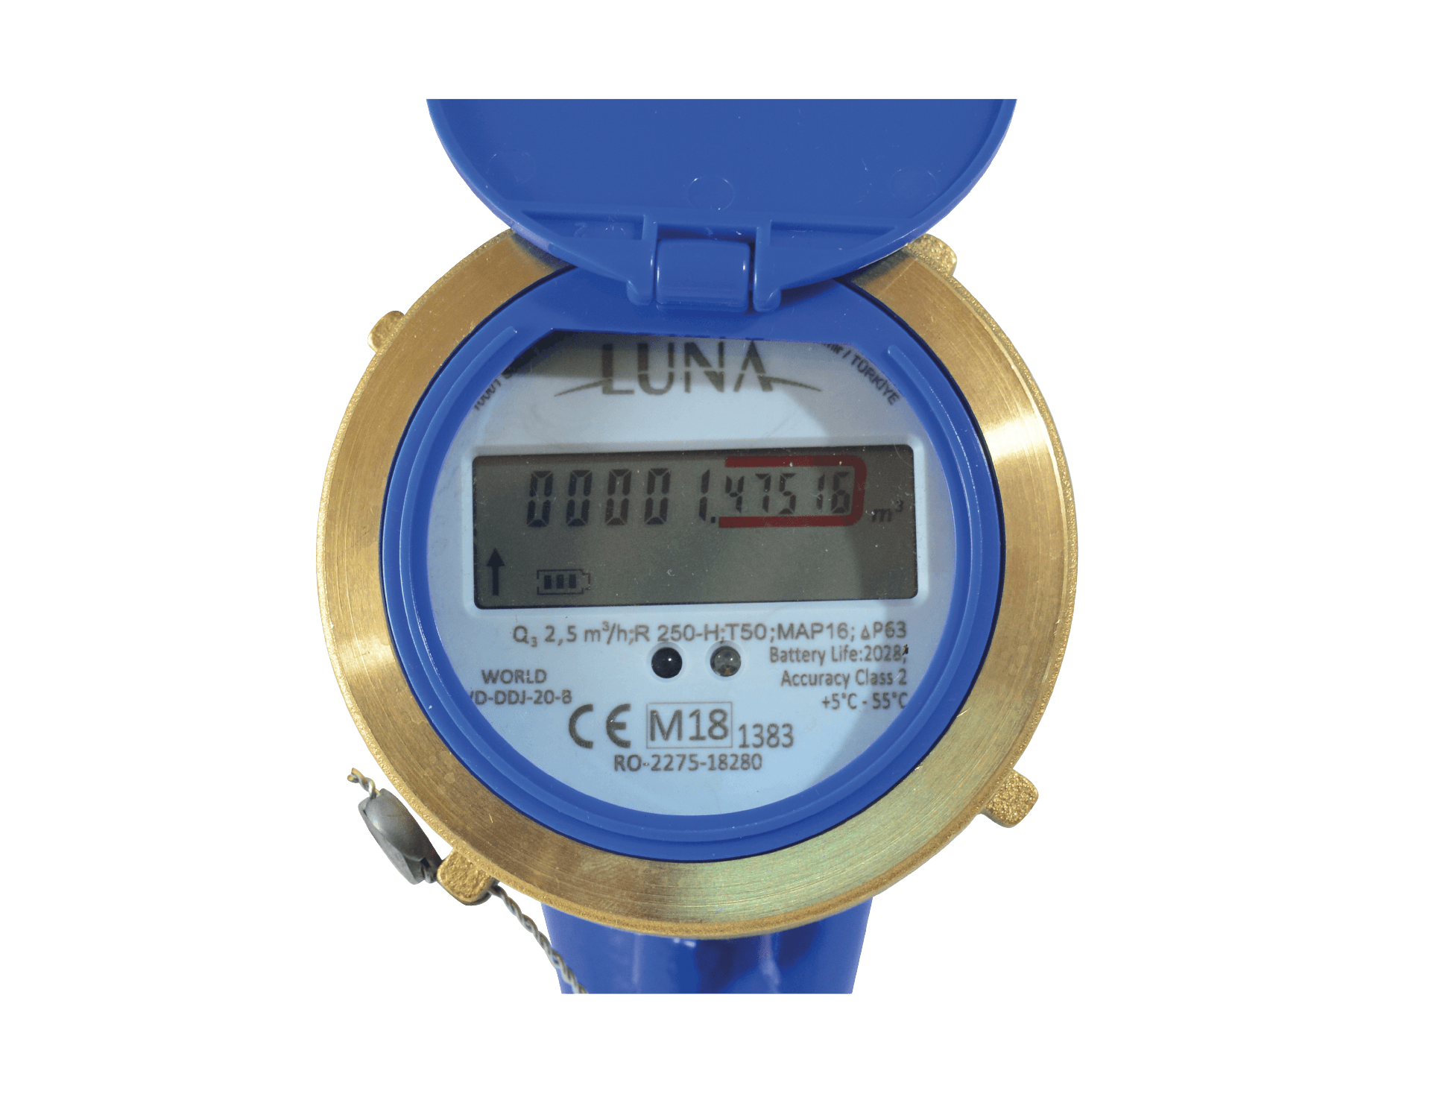
KILL BILL: Digital meters and timing of digital meters

Slide 16
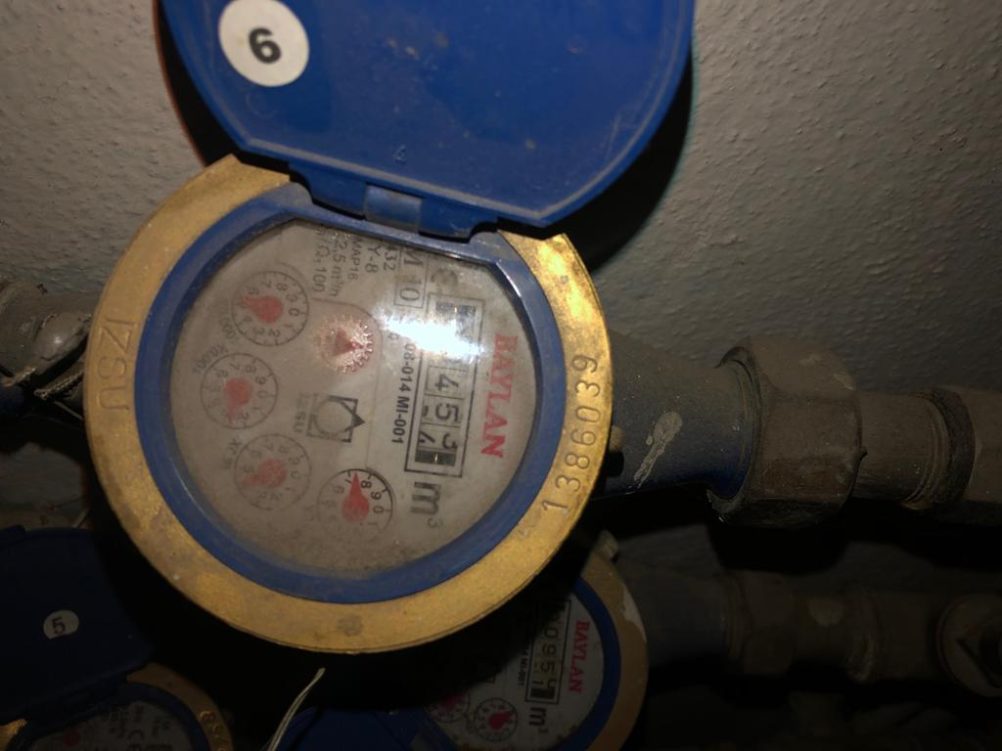
KILL BILL: Reflection of the flash light from the glass

Slide 17



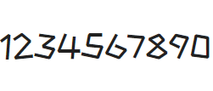
KILL BILL: Character types of different meters

Slide 18
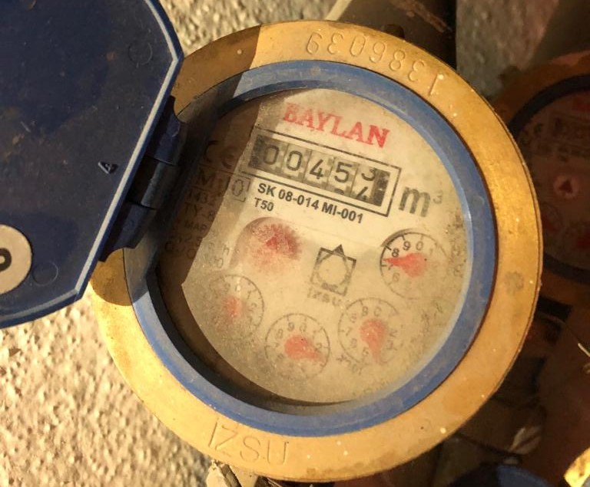
KILL BILL: Changing characters

Slide 19
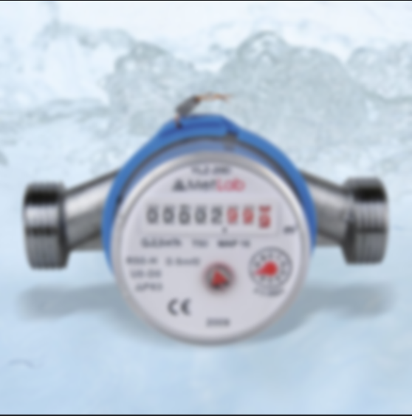
KILL BILL
Other possible problems with image processing

Slide 20
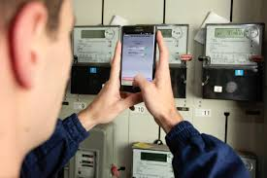
KILL BILL: Problem due to hardware system

Slide 21

KILL BILL
Mobile application part is the answer to question how the users will use the Kill Bill.

Slide 22
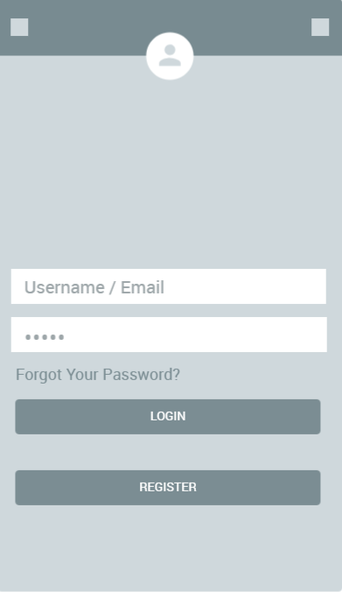
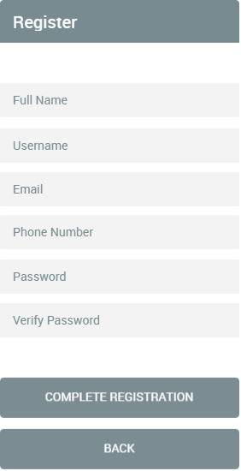
KILL BILL: Mock-Ups
Login Interface
Register Interface

Slide 23
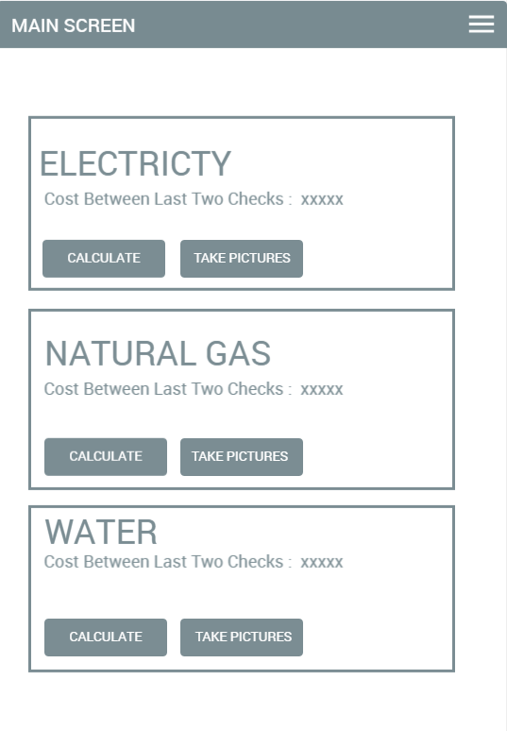
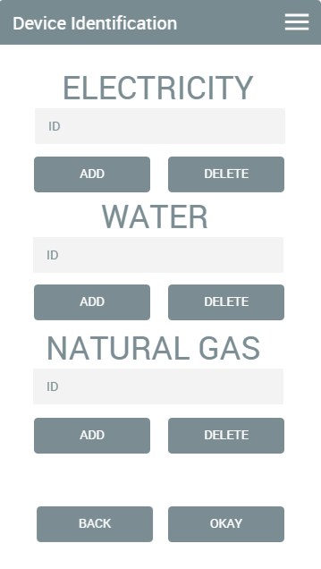

KILL BILL: Mock-Ups
Main Screen Interface
Device Identification Interface

Slide 24
KILL BILL
Kill Bill stores 2 different types of information;
USER INFORMATION
User registration
Authentication System
DEVICE INFORMATION
Device Ids
String values which were taken from meters

Slide 25
KILL BILL
What do we have in our application, What do others have?
 | Online Payment | Usage Analysis | View bill prices momently | Hardware Connection | Price As Free | IOS Market | Android Market
KILL BILL (Proposed) | NO | YES | YES | YES | YES | NO | YES
PayTM | YES | YES | NO | NO | YES | YES | YES
Mahavitaran | YES | YES | NO | NO | NO | NO | YES
PhonePE | YES | YES | YES | NO | YES | YES | YES

Slide 26
KILL BILL
How will the developing this project improve our skills?
We are not electric and electrical engineering students
We do not know how to use Raspberry Pi system
We gain more experience about software systems
We gain experienced that hardware and software systems could be work together

Slide 27

KILL BILL

